Slide 1
Optimization Algorithms
Dai Bui

Slide 2




Gradient Descent Optimizations
Gradient descent update
Now, consider a function
let us calculate the gradient
$$W=W−α\frac{∂L}{∂W}$$
$$W=\left[\begin{matrix}w_{0} \\ w_{1}\end{matrix}\right]$$
$$L\left(W\right)=4w_{0}^{2}+w_{1}^{2}$$
$$\frac{∂L}{∂w_{0}}=8w_{0}$$
$$\frac{∂L}{∂w_{1}}=w_{1}$$

Slide 3

SDG with Momentum
Can mitigate the zig-zag effect?
Velocity is the running mean of the gradients
$$v_{t}=ρv_{t−1}+∇f\left(x_{t}\right)$$
$$x_{t+1}=x_{t}−αv_{t+1}$$

Slide 4
SGD with Momemtum
Will it help with loss functions with local minim or saddle points

Slide 5

AdaGrad
$$sum_squared+= {\left(∇f\left(x\right)\right)}^{2}$$
$$x_{t+1}=x_{t}−\frac{α∇f\left(x\right)}{\sqrt{sum_squared}+{10}^{−7}}$$
What happens with the step size over time?

Slide 6

RMSProb
$$sum_squared=β ∗ sum_squared+(1−β) {\left(∇f\left(x\right)\right)}^{2}$$
$$x=x−\frac{α∇f\left(x\right)}{\sqrt{sum_squared}+{10}^{−7}}$$
$β$ is the learning rate

Slide 7
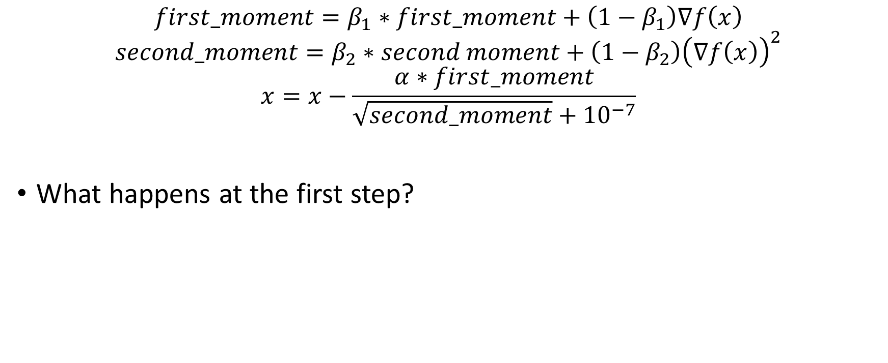
Adam (naïve)
$$first_moment=β_{1}∗first_moment+\left({1−β}_{1}\right)∇f\left(x\right)$$
$$second_moment=β_{2}∗second moment+\left(1−β_{2}\right){\left(∇f\left(x\right)\right)}^{2}$$
$$x=x−\frac{α∗first_moment}{\sqrt{second_moment}+{10}^{−7}}$$
What happens at the first step?
Momentum
AdaGrad/RMSProp

Slide 8

Adam (adjusted)
$$first_moment=β_{1}∗first_moment+\left({1−β}_{1}\right)∇f\left(x\right)$$
$$second_moment=β_{2}∗second moment+\left(1−β_{2}\right){\left(∇f\left(x\right)\right)}^{2}$$
$$first_unbias=\frac{first_moment}{(1−β_{1}^{iteration})}$$
$$second_unbias=\frac{second_moment}{(1−β_{2}^{iteration})}$$
$$x=x−\frac{α∗first_unbias}{\sqrt{second_unbias}+{10}^{−7}}$$
Bias correction for first and second moment that start at zero
Momentum
AdaGrad/RMSProp

Slide 9
Learning Rate Decay
Which is the best learning rates?

Slide 10
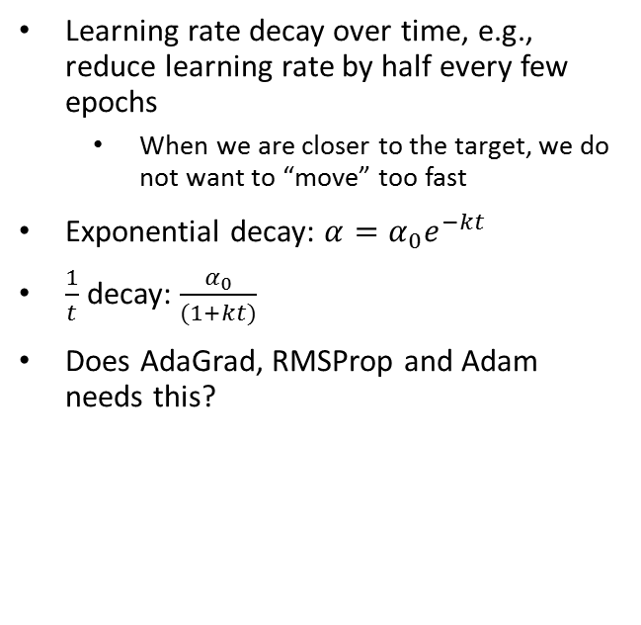
Learning Rate Decay
Learning rate decay over time, e.g., reduce learning rate by half every few epochs
When we are closer to the target, we do not want to “move” too fast
Exponential decay: $α=α_{0}e^{−kt}$
$\frac{1}{t}$ decay: $\frac{α_{0}}{(1+kt)}$
Does AdaGrad, RMSProp and Adam needs this?

